Slide 1
UNIVERSITA’ DI MILANO-BICOCCA
LAUREA IN INFORMATICA
Corso di
Analisi e Progetto di Algoritmi
Prof. Giancarlo Mauri
Lezione 29-32
Problemi NP-completi

Slide 2
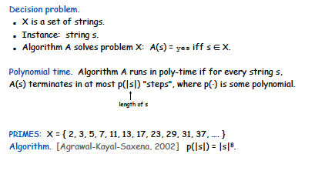
Decision problems

Slide 3
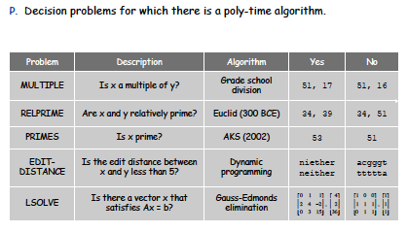
Definition of P

Slide 4
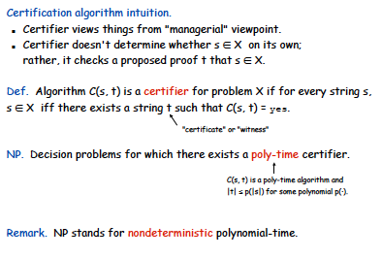
NP

Slide 5
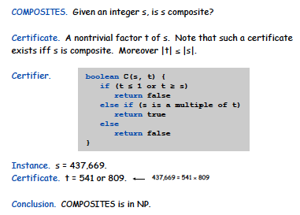
Certifiers and certificates

Slide 6
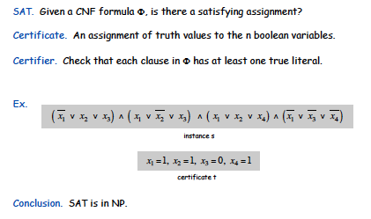
Certifiers and certificates

Slide 7
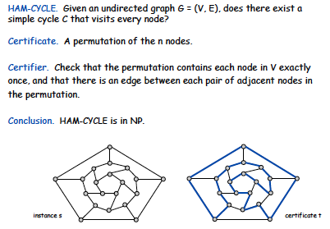
Certifiers and certificates

Slide 8
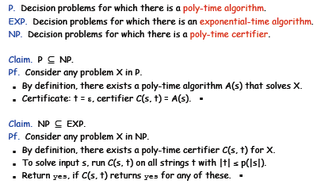
P, NP, EXP

Slide 9
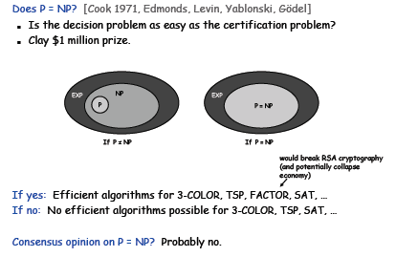
The main question: P versus NP

Slide 10
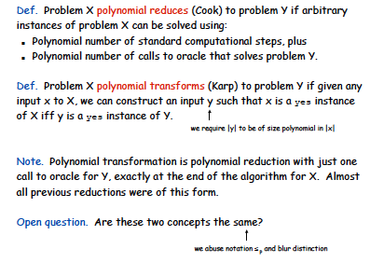
Polynomial transformation

Slide 11
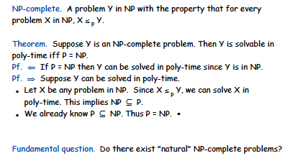
NP-completeness

Slide 12
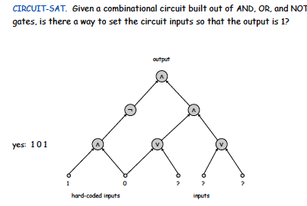
Circuit satisfiability

Slide 13
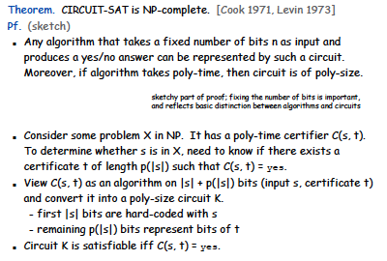
The first NP-complete problem

Slide 14
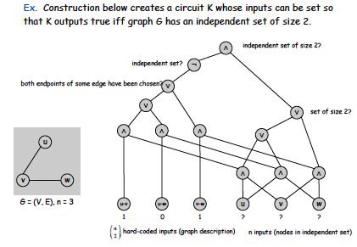
Example

Slide 15
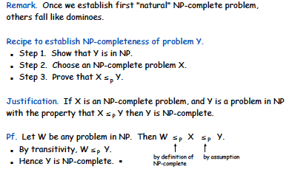
Establishing NP completeness

Slide 16
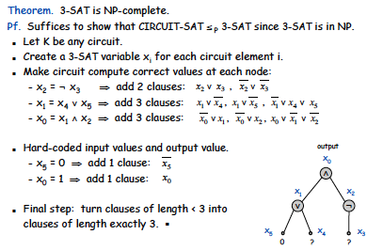
3-SAT is NP complete

Slide 17
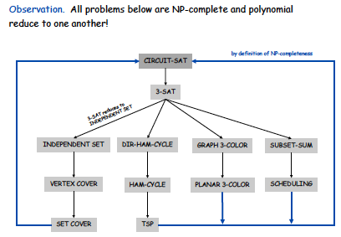
Some examples

Slide 18
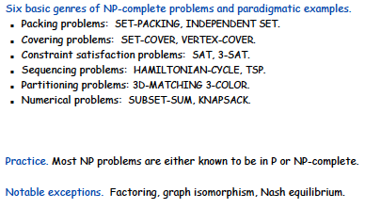
Some examples

Slide 19
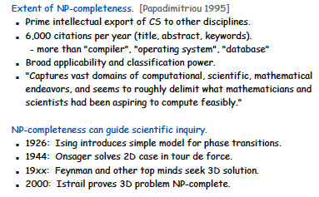
Extent and impact of NP-completeness

Slide 20
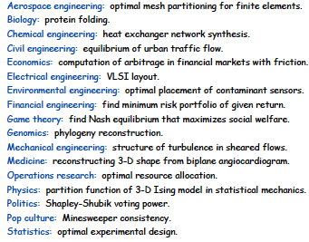
More hard problems

Slide 21
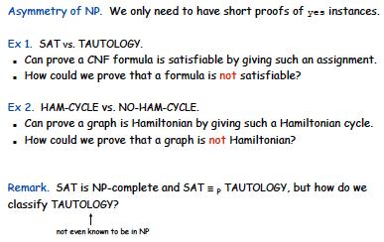
Asymmetry of NP

Slide 22
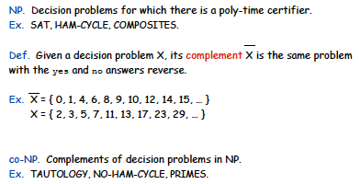
Co-NP

Slide 23
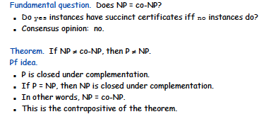
NP = co-NP ?

Slide 24
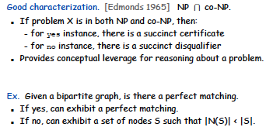
Good characterizations

Slide 25
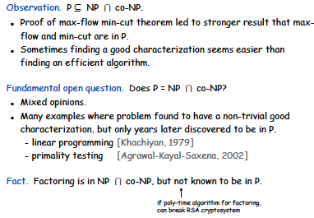
Good characterizations

Slide 26
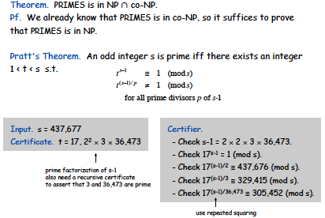
PRIMES is in NP ∩ co-NP

Slide 27
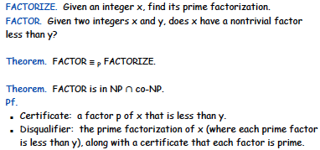
FACTOR is in NP ∩ co-NP

Slide 28
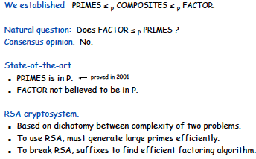
Primality Testing and Factoring

